Slide 1


GOLD PRICE PREDICTION ANALYSIS
LAVIKA SINGLA
2210990540

Slide 2
INTRODUCTION
In today's volatile financial markets, the ability to accurately predict asset prices is paramount for investors and analysts alike. Our project focuses on the crucial task of forecasting gold prices, a commodity renowned for its status as a safe-haven investment and its influence on global economic trends.
Through this project, we seek to address the following key points:
Brief Overview: We delve into an extensive analysis of historical data encompassing various market factors, including the S&P 500 Index, oil prices, silver prices, and currency exchange rates.
Importance of Predicting Gold Prices: Gold serves as a vital asset class with significant implications for investors, central banks, and policymakers worldwide. Accurate predictions of gold prices enable stakeholders to make informed decisions, mitigate risks, and capitalize on opportunities in the financial markets.
Objective: Our primary goal is to develop a machine learning model capable of forecasting gold prices with precision and reliability. By employing advanced regression techniques, we aim to uncover underlying patterns and relationships within the data to enhance our predictive capabilities.

Slide 3
DATA OVERVIEW
SUMMARY OF DATASET CHARACTERISTICS
KEY FEATURES
Our dataset comprises historical records encompassing various market factors crucial for understanding gold price movements. Key features include:
SPX (S&P 500 Index): Reflects the performance of the leading 500 publicly traded companies in the United States, serving as a barometer for overall market sentiment and economic health.
USO (United States Oil Fund): Represents the price of crude oil, a vital commodity influencing global economic activity and serving as an indicator of energy market dynamics.
SLV (iShares Silver Trust): Tracks the price of silver, often considered alongside gold as a precious metal and subject to similar market forces and investor sentiments.
EUR/USD (Euro to US Dollar exchange rate): Indicates the value of the euro relative to the US dollar, reflecting currency market dynamics and impacting international trade and investment flows.
This comprehensive dataset enables us to explore the interplay between these factors and gold prices, providing valuable insights into the complex dynamics of financial markets.
SPX (S&P 500 Index)
USO (United States Oil Fund)
SLV (iShares Silver Trust)
EUR/USD (Euro to US Dollar exchange rate)

Slide 4
DATA EXPLORATION
VISUALIZATIONS
INSIGHTS
Heatmap showing correlation between features
Distribution plot of Gold (GLD) prices
High correlation between Gold (GLD) and Silver (SLV)
Gold price distribution is roughly normal

Slide 5

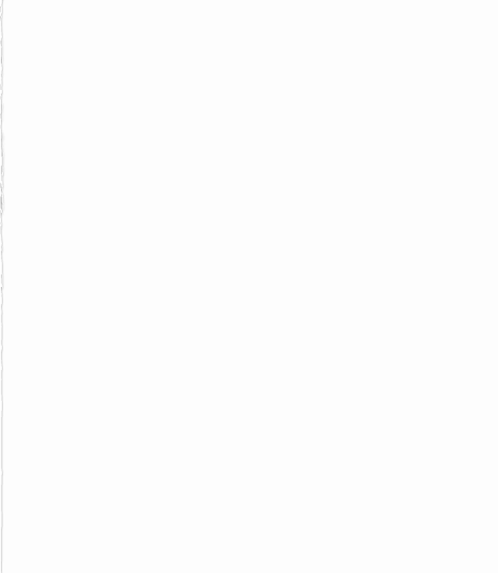
MODEL TRAINING
Splitting the data into training and testing sets
Utilization of Random Forest Regressor for training
Evaluation metrics:
R-squared error on training data
R-squared error on testing data

Slide 6
MODEL EVALUATION
High Score on Training Data (>0.99): This indicates the model fits the training data exceptionally well, explaining over 99% of the variance in gold prices. It shows the model effectively learns from the training data.
Slightly Lower Score on Testing Data (Still >0.98): Despite being slightly lower than the training score, a score >0.98 demonstrates the model's ability to generalize to new, unseen data, suggesting it can make accurate predictions beyond the training dataset.
This brief explanation highlights the model's strong performance in both fitting the training data and generalizing to new data, showcasing its reliability for predicting gold prices.

Slide 7
ACTUAL V/S PREDICTED PRICE
Actual vs Predicted Prices, we showcase a line plot contrasting actual gold prices with our model's predictions. By visually comparing the blue (actual) and green (predicted) lines, we can assess the model's accuracy. Any deviations observed indicate discrepancies between the model's forecasts and real market prices, offering insights into potential areas for improvement and refining the predictive model.

Slide 8
CONCLUSION
Successful implementation of Random Forest Regression for accurate gold price prediction.
Valuable insights gained through thorough data exploration into market dynamics.
Future steps include refining the model, exploring additional features, and ongoing performance monitoring.
Represents a significant advancement in leveraging machine learning for gold price forecasting, providing actionable insights for stakeholders.

Slide 9
THANKYOU
SUBMITTED TO:
MR.TUSHAR TKHITOLIYA

